Slide 1
Online AI Dietitian
By
Yash Rane

Slide 2
Introduction
Smart phones and the Internet have revolutionized the communication and with it the lifestyle of people. An increasing number of smart phones and Personal Digital Assistants (PDA) allow people to access the Internet where ever they are and whenever they want. By using internet they can obtain on one hand information on almost everything they wish to. Therefore just by using smart phones user can get diet assistance anytime at free of cost. Artificial dietitian is an application with artificial intelligence about human diets. It acts as a diet consultant similar to a real dietitian . This system acts in a similar way as that of a dietitian .A Person in order to know his/her diet plans needs to give some information to the dietitian such as its body type, weight, height, and working hour details.
Similar way this system also provides the diet plan according to the information entered by the user. The System asks all his data from the user and processes it to provide the diet plan to the user. Thus the user does not need to visit any dietitian which also saves time and the user can get the required diet plan in just a click.

Slide 3
The project also has a login page where in the user is required to register his/her account then they can use the app. This project requires Internet access and thus there is a disadvantage of server failure.
The system give more accurate results as it accepts the data entered by the user and process it depending on some metrices already known to the application on the basis of which a diet plan is generated and ask her the user if the user accepts the diet plan. If not accepted the system may also give an alternatve diet plan.

Slide 4
Background
Just similar to a human dietician, this web system will also act like your dietician. When you go to a doctor of nutrition, then she will ask you your personal details related to body and health such as your age, your height, your weight and how much water do your consumer in a day and how much walk to do take regularly and how much work do you do regularly. Just similar to this doctor, this artificial intelligent dietitian also asks you similar questions in your device and you have to answer all those questions and then this AI consultant will also advice you about what should your intake in your diet and what should you ignore in order to keep yourself healthy via your diet.

Slide 5
Objective
In this system of artificial intelligence dietitian, using the technique of artificial intelligence, you will get access to all the facilities via this web application, which is actually provided by a human dietician. The main advantage of using this web application is that the time required by the people to travel to the dietician will be reduced and also it reduces the cost of hiring dieticians for some particular purpose. Also, this application offers more than one diet plan also, for some particular kind of functionalities of human bodies.

Slide 6
Purpose
The online artificial dietician is a bot with artificial intelligence about human diets. It acts as a diet consultant similar to a real dietician. Dieticians are educated with nutrient value of foods. A dietician consults a person based on his schedule, body type, height and weight. The system too asks all this data from the user and processes it. It asks about how many hour the user works, his height, weight, age etc. The system stores and processes this data and then calculates the nutrient value needed to fill up users needs. The system then shows an appropriate diet to the users and asks if user is ok with it, ,else it shows other alternate diets to fill up users needs.

Slide 7
SCOPE:
No need of consulting doctor for diet plans.
This system provides full details of the nutrient constitution in body and if required more or not along with the plan by just answering to some queries.
Saves money and very effective and give accurate results as it is coded with keeping diet chart in mind.
There are alternative diet chart provided by the system if the user don't like any.

Slide 8
Applicability:
Dietitians can use this system to make sure what they recommend patients.
This system can be very well used in medical colleges for teaching and practicing purposes so that student can learn from it.
This system can also be utilized in gym particularly for calculating the customers' calories and diet plans.
Individual can also use this software especially for themselves in home

Slide 9
Achievements
Prevent health conditions from getting worse
If we concerned that heart disease, diabetes or high blood pressure is trending in our family, we can benefit from the coaching of a registered dietician nutritionist. To reduce our risk for developing these chronic conditions, we can work with a nutritionist to prepare meals tailored to our dietary needs. Look for a nutritionist who specifically addresses our health concerns - such as lowering our cholesterol levels and improving blood glucose levels, which can ultimately reduce or eliminate the need for medications.
Meet our fitness goals
Whether we want to hit the snowshoe trails or the slopes this winter, a sports nutritionist can support our training by developing tailored meal plans for your fitness goals. A registered dietician or registered dietician nutritionist has fulfilled a specially designed, accredited nutrition curriculum and many hold graduate degrees, so look for one that's right for our specific nutritional needs

Slide 10
We start to feel our age
If we start to feel sluggish, seeing poor lab results or our doctor wants us to make changes, a nutritionist can help. A whole food, plant-based diet addresses chronic inflammation in our body, positively impacting our cardiovascular functioning and hormonal balance. Incorporate more fresh foods and vegetables and other “unprocessed foods”, such as whole grains, seeds, nuts, legumes and healthy fats (olive oil, canola, avocado and flaxseed). Fatty fish and other lean proteins such as chicken should be part of a healthy diet. In addition, eating better will improve our memory and brain function, and may help reduce auto-immune diseases such as arthritis.
The weight impacts of our health and lifestyle
To lose weight, we need to take in fewer calories than we use, in addition to paying attention to timing of meals and the nutrient content of our diet. This can make it hard to eat right and lose weight on our own. LifeWise members may get discounts to gyms and weight loss programs.Also, if we want a nutritionist who specializes in a specific chronic disease, such as diabetes, LifeWise's customer support can help us identify a nutritionist.
Certain foods are making us sick
If we suspect that food sensitivities or allergies are contributing to skin or digestive problems, we have benefit from the help of a nutritionist. The process of eliminating and bringing back certain foods into our diet will help you zero-in on what is causing your health issues. A nutritionist can help us sort through a variety of healthy foods and diets, and identify what's impacting our health.

Slide 11
PROBLEM DEFINITION
In the existing system, you have to hire a dietician in order to get advice. Hiring a nutrition doctor will not only waste your time and efforts for calling them, going to them and so on but also cost you very high as their charges per month are very high. The moment will also arrive when they will not available for you and you have to search for some other dietician urgently.
Traditionally, one has to travel for consulting Dietitian in his/her clinic which consumes time as well as it proves frenetic in transportation.
Implementing such system in real world will reduce the efforts of travelling on busy roads and will save the time.
No such System has been developed for counselling.
Clinics are being overcrowded sometimes and the person is left dejected when the query is delayed to next day just because finished visiting hours.
Pressure mounts on the human Dietitians when the number of waiting patients increases.

Slide 12
Proposed System
Considering the anomalies in the existing system computerization of the whole activity is being suggested after initial analysis.
“Artificial Intelligence Dietitian” is a BOT with artificial intelligence about human diets.
It acts as a diet consultant similar to a real Dietitian
User may login and view various diet information
A Dietitian consults a person based on his schedule, body type, height and weight. The system too asks all this data from the user and processes it.
It asks about how many hours the user works, his height, weight, age etc.
It stores and processes the above data and then calculates the nutrient value needed to fill up user’s needs.
It then shows an appropriate diet to the users and asks if user is ok with it, else it shows other alternate diets to fill up user’s needs.
The web application also contains chat, where a user or a dietitian can chat with each other and ask or solve their queries related to diet.

Slide 13
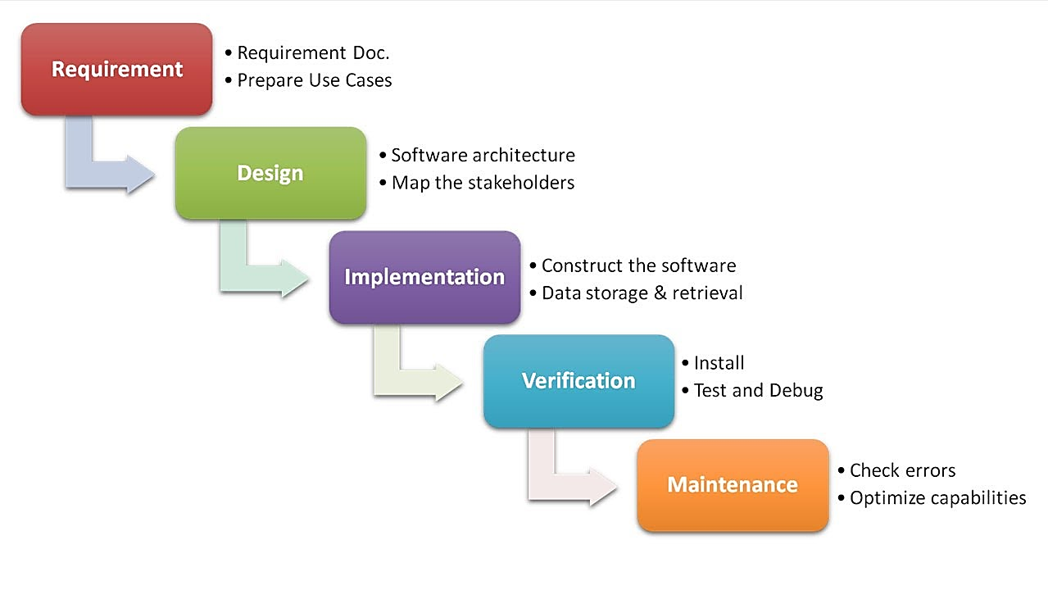
Project Lifecycle Details
Waterfall Model

Slide 14
REQUIREMENT SPECIFICATION
Considering the anomalies in the existing system computerization of the whole activity is being suggested after initial analysis.
It acts as a diet consultant similar to a real Dietitian
User may login and view various diet information
A Dietitian consults a person based on his schedule, body type, height and weight. The system too asks all this data from the user and processes it.
It asks about how many hours the user works, his height, weight, age etc.
It stores and processes the above data and then calculates the nutrient value needed to fill up user’s needs.
It then shows an appropriate diet to the users and asks if user is ok with it, else it shows other alternate diets to fill up user’s needs.
The web application also contains chat, where a user or a dietitian can chat with each other and ask or solve their queries related to diet.

Slide 15
PROJECT IMPLEMENTATION
The Project is loaded in Visual Studio 2010. We used Visual Studio for Design and coding of project. Created and maintained all databases into SQL Server 2008, in that we create tables, write query for store data or record of project.

Slide 16
SOFTWARE AND HARDWARE REQUIREMENTS
Hardware Requirement:
i3 OR i5 Processor Based Computer
2GB-Ram
5 GB Hard Disk
Internet Connection
Software Requirement:
Windows 7 or higher
Visual Studio 2010
SQL Server 2008
Google Chrome Browser

Slide 17
PRELIMINARY PRODUCT DESCRIPTION
Considering the anomalies in the existing system computerization of the whole activity is being suggested after initial analysis.
“Artificial Intelligence Dietitian” is a BOT with artificial intelligence about human diets.
It acts as a diet consultant similar to a real Dietitian
User may login and view various diet information
A Dietitian consults a person based on his schedule, body type, height and weight. The system too asks all this data from the user and processes it.
It asks about how many hours the user works, his height, weight, age etc.
It stores and processes the above data and then calculates the nutrient value needed to fill up user’s needs.
It then shows an appropriate diet to the users and asks if user is ok with it, else it shows other alternate diets to fill up user’s needs.
The web application also contains chat, where a user or a dietitian can chat with each other and ask or solve their queries related to diet.

Slide 18
System Architecture:

Slide 19
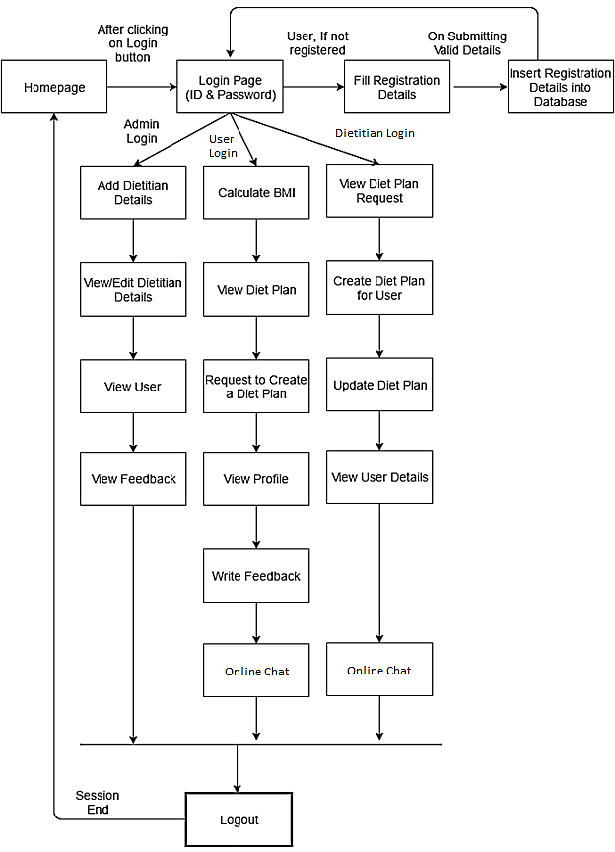

Slide 20
Algorithm

Slide 21
Step 1: Start
Step 2: Click on the Login Option.
Step 3: Enter Correct UserId and Password.
Step 4: If User not Remembered the Password then click on the Forgot Password Option.
Step 5: Enter New Password then confirm the Password.
Step 6: Then Enter the UserId and New Password for Login.
Step 7: Enter the Login Button.
Step 8: Verify the UserId and Password.
Step 9: User will go the Website.
Step 10: If User is Not Registered then go to the Registration page.
Step 11: Fill Registration Details.
Step 12: Submit the Registration Details.
Step 13: User will go to the WebSite.
Step 14: User can calculate the BMI and the request for Diet Plan according to his/her Physical Conditions.
Step 15: User can Consult with Dietitian through Online Chat.
Step 16: If User will Logout.
Step 17: Stop.

Slide 22
Modules and their Description
This website is having 3 major modules with its sub-modules as follows:
Admin Login
Add Dietitian: System allows admin to add a dietitian details into the system who can create the diet plan for the users.
View/Edit Dietitian: Can view and edit the dietitian details whenever required.
View User: Can view the list of registered users with their details.
View Feedback: Can view feedback provided by the registered users.

Slide 23
User Login
Register: To continue with the diet plan details, user first need to fill up all the required details.
Calculate BMI: Based on details provided by the user, system
automatically calculate the BMI of the user.
View Diet Plan: The diet plan for the user is generated by the system itself using artificial intelligence.
Request Diet Plan: If the user is unsatisfied with the diet plan provided by the system, the he/she can raise a request to generate the proper diet plan him/herself. The diet plan request is forwarded to dietitian.
Chat: User can chat with the dietitian and ask or solve their queries online.
View Profile: User can view his/her own profile.
Write Feedback: Registered users can provide the feedback.

Slide 24
Dietitian Login
View Diet Plan Request: Here, dietitian can view the diet plan request from the users.
Create Diet Plan: Based on user’s request, dietitian creates a diet plan for him/her.
Update Diet Plan: The user resends the request to dietitian about unsatisfied diet plan. Therefore, as per the user’s request, dietitian regenerates the diet plan and sends to the user.
View User: Can view user details as a when needed.
Chat: A Dietitian can chat with the dietitian and ask or solve user’s queries online.

Slide 25
Screenshots

Slide 26
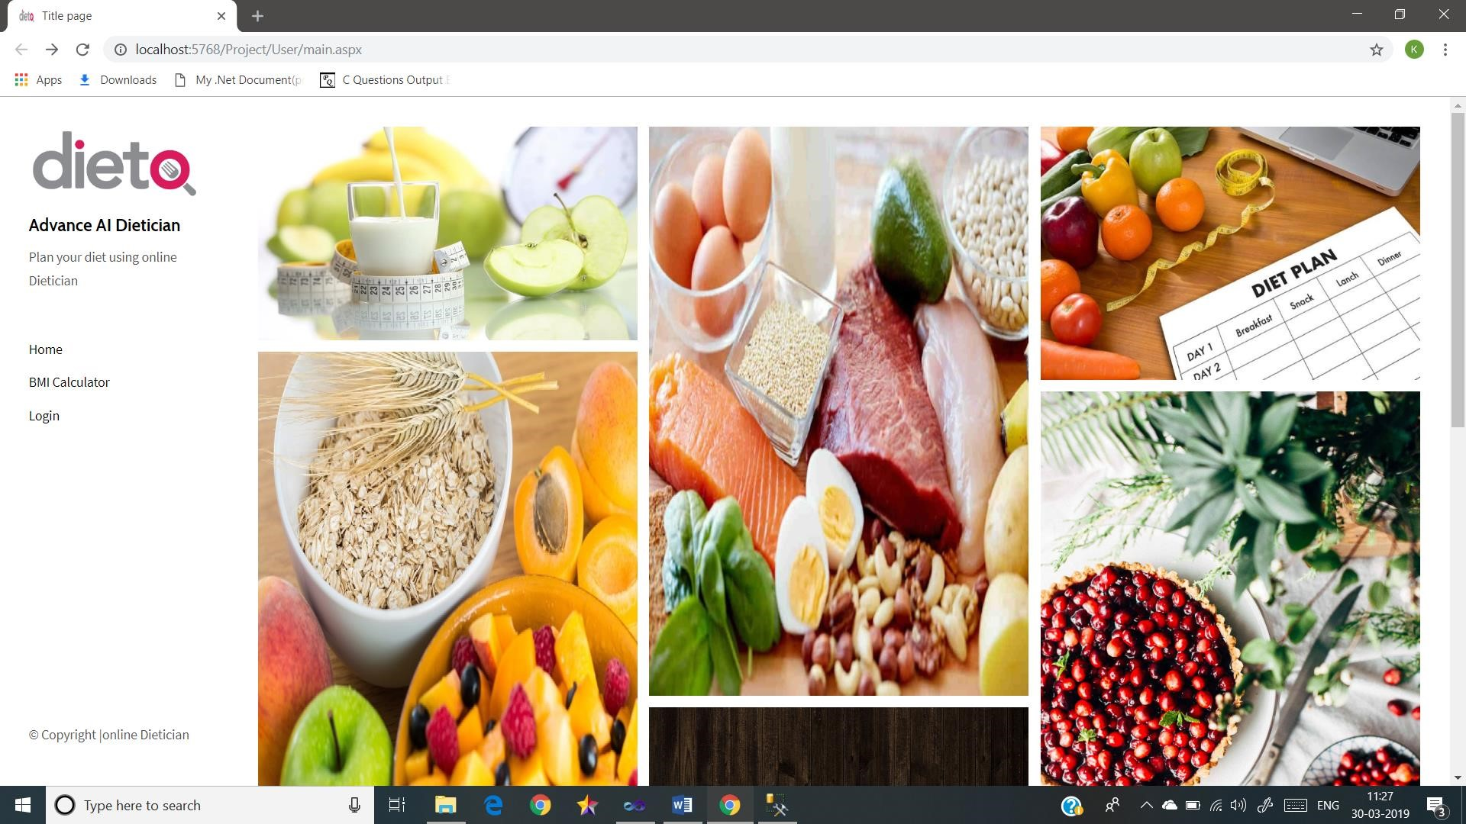
Home Page

Slide 27
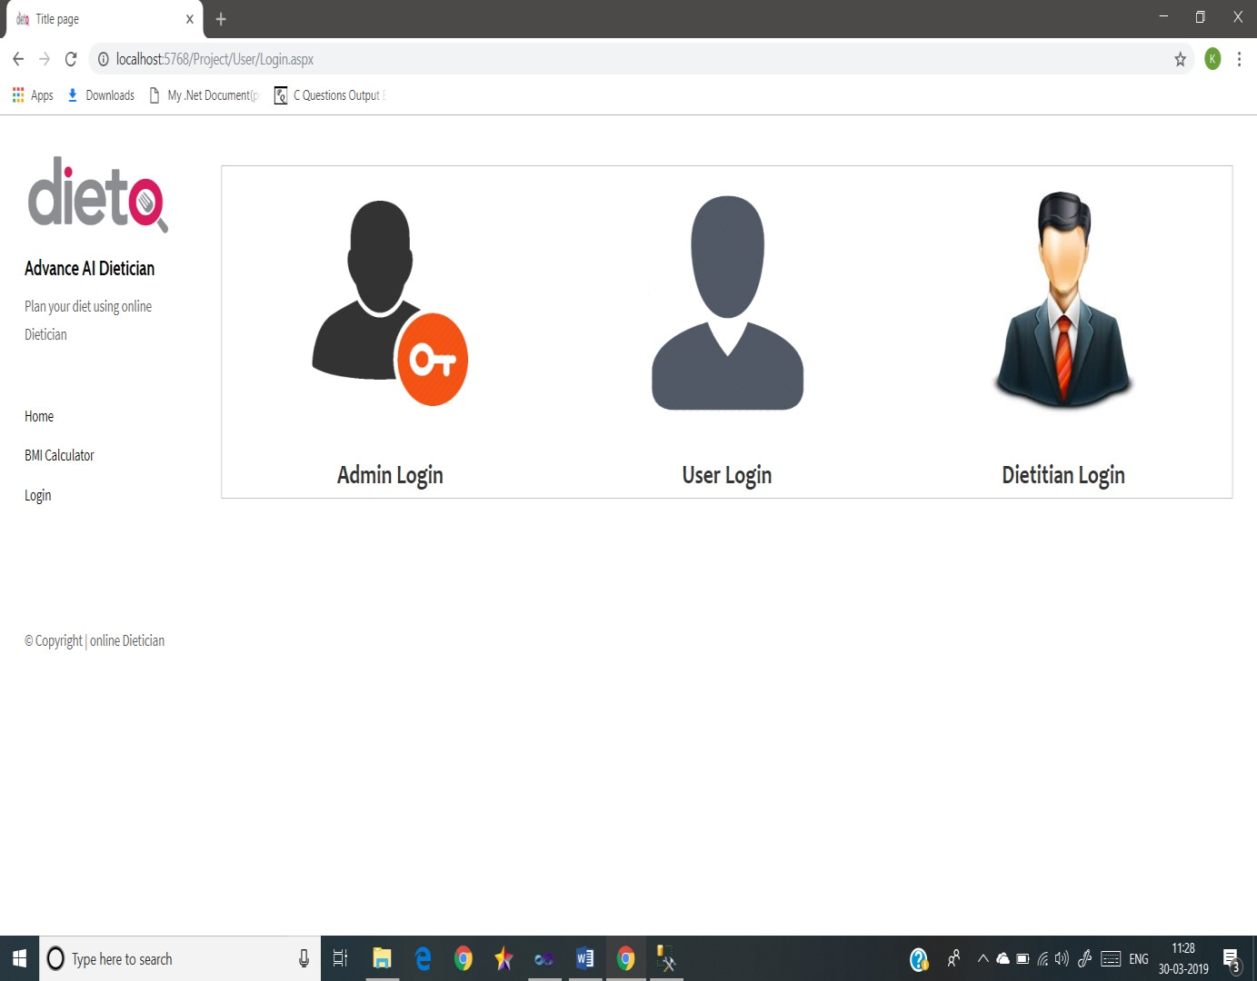
Login Page

Slide 28
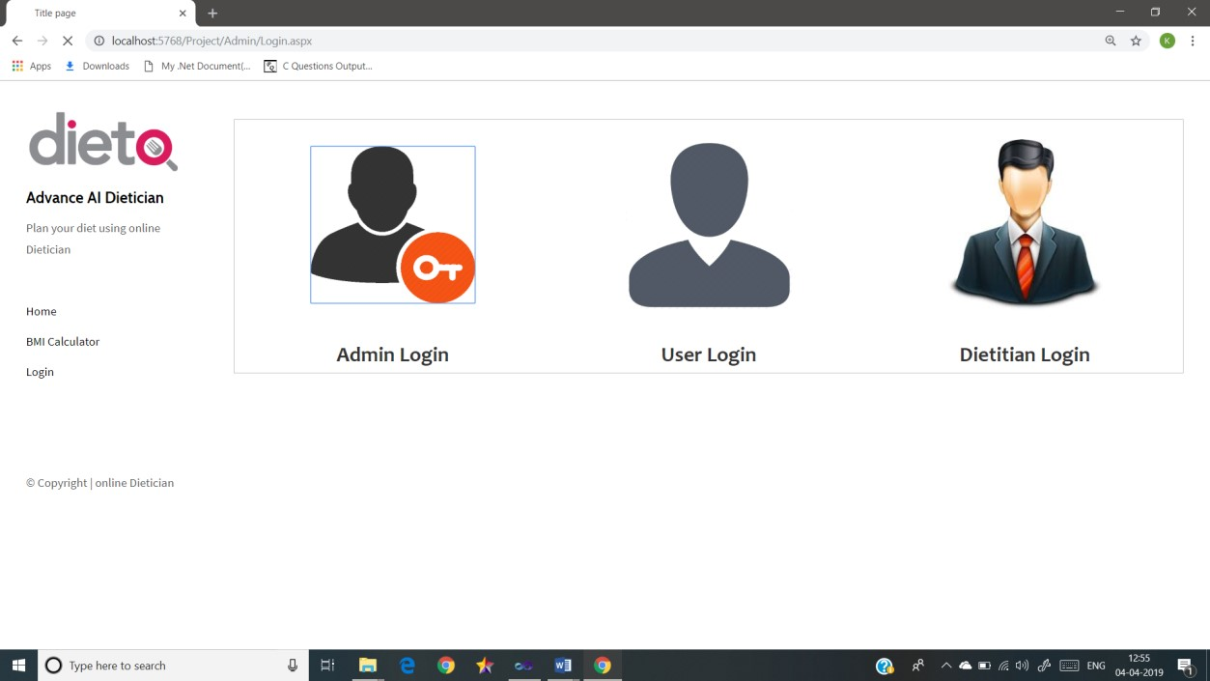
Admin Login

Slide 29
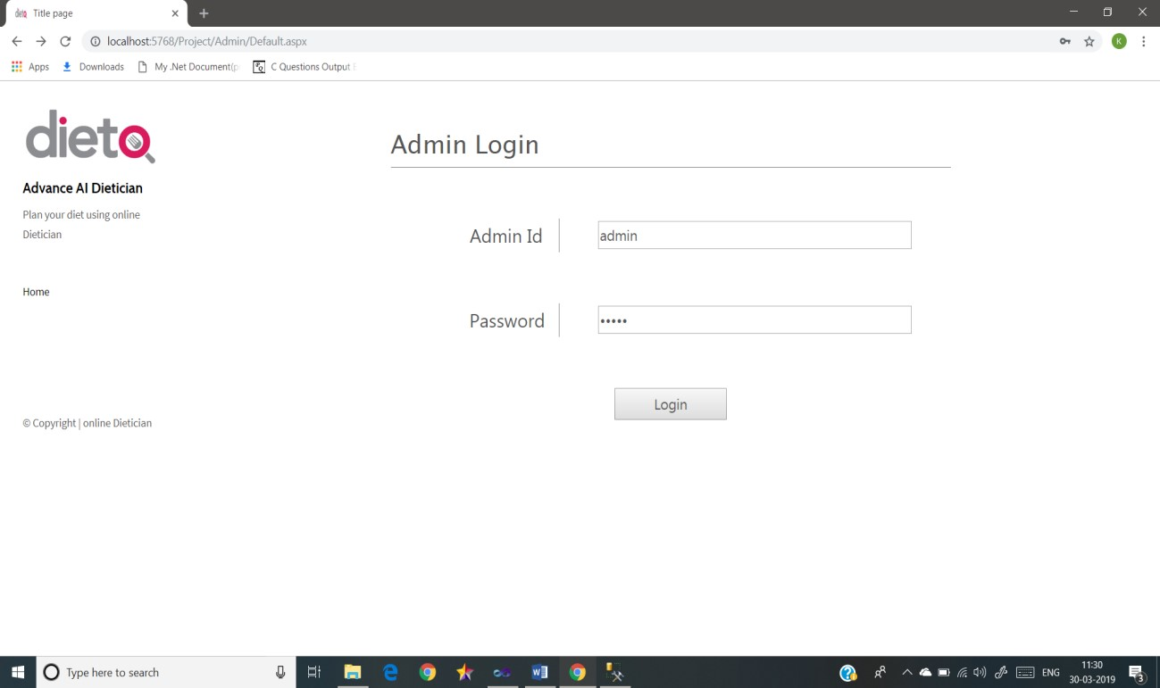

Slide 30
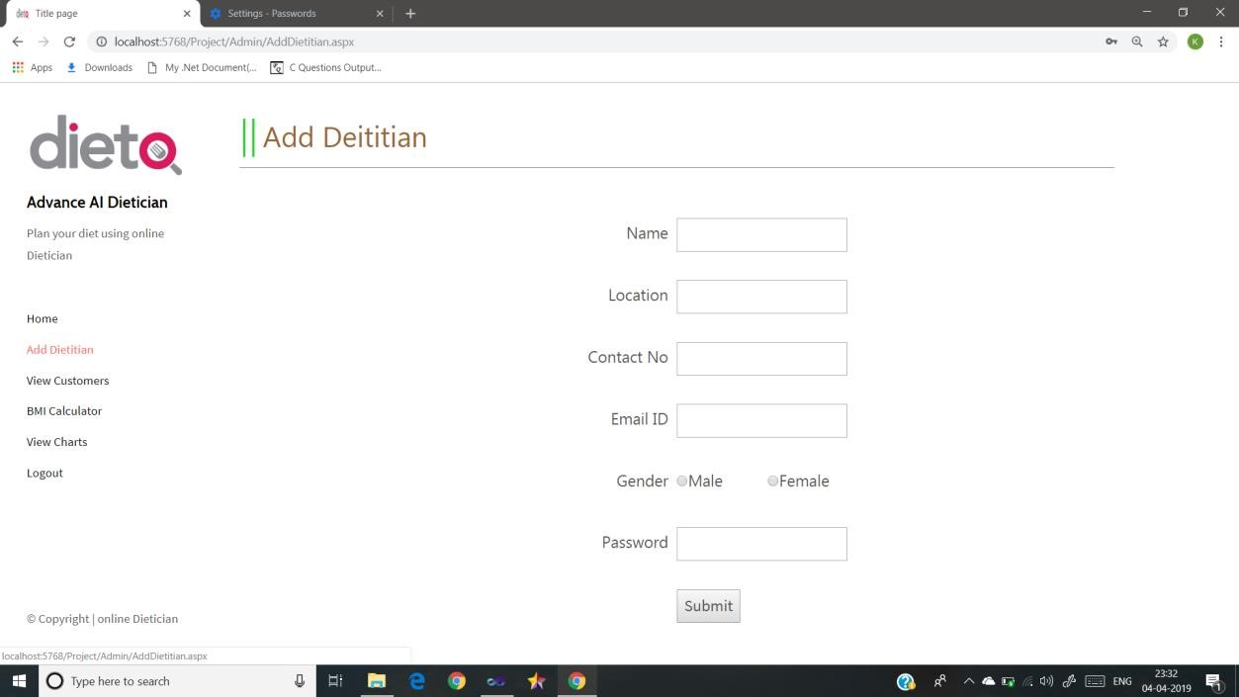

Slide 31
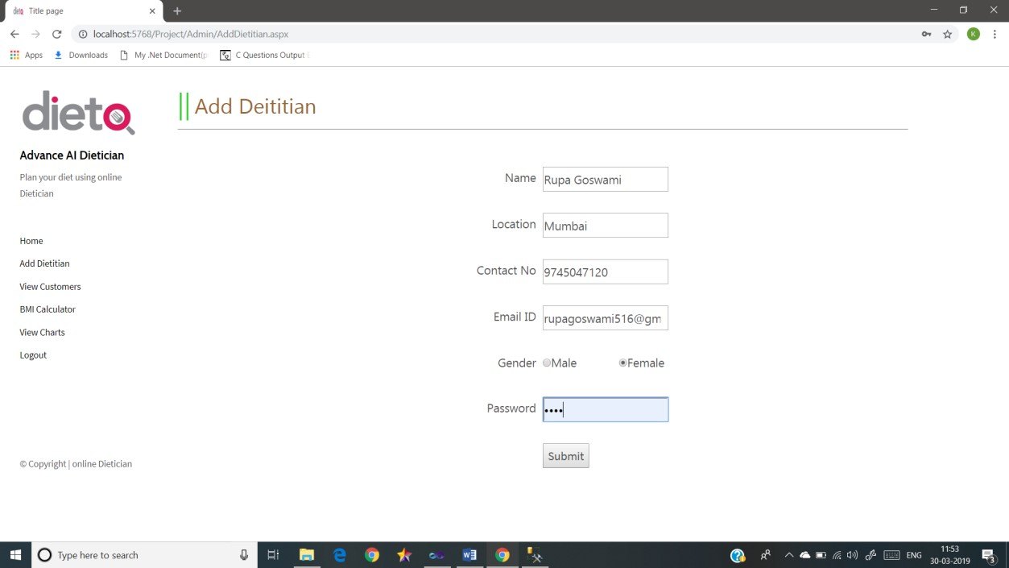

Slide 32
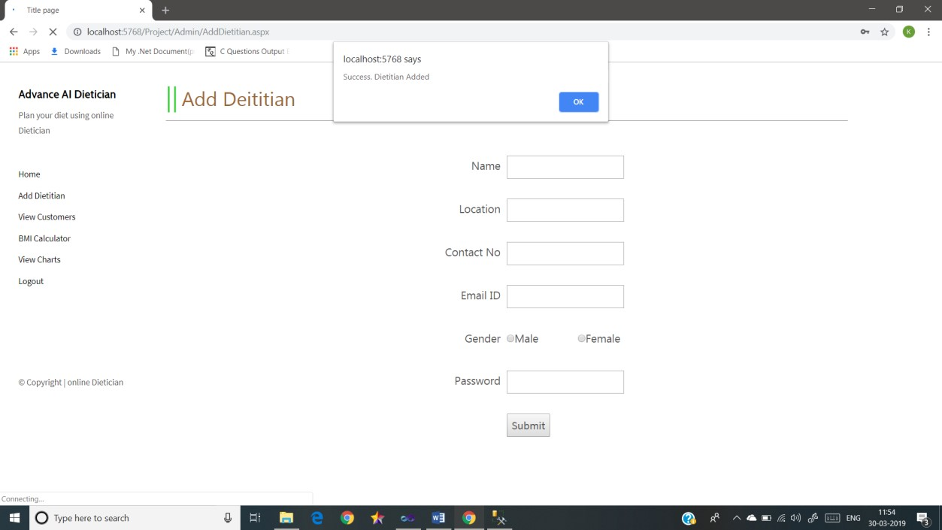

Slide 33
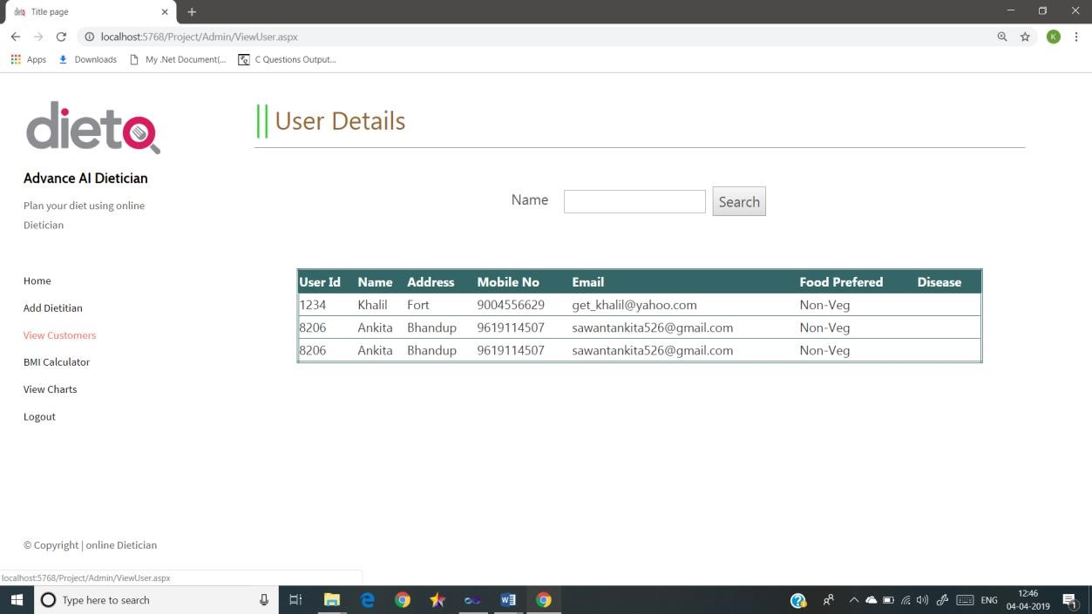

Slide 34
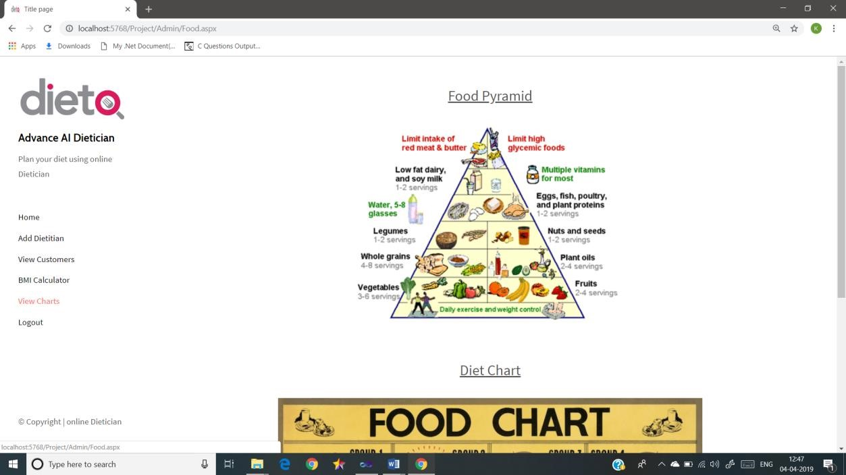

Slide 35

User Login

Slide 36
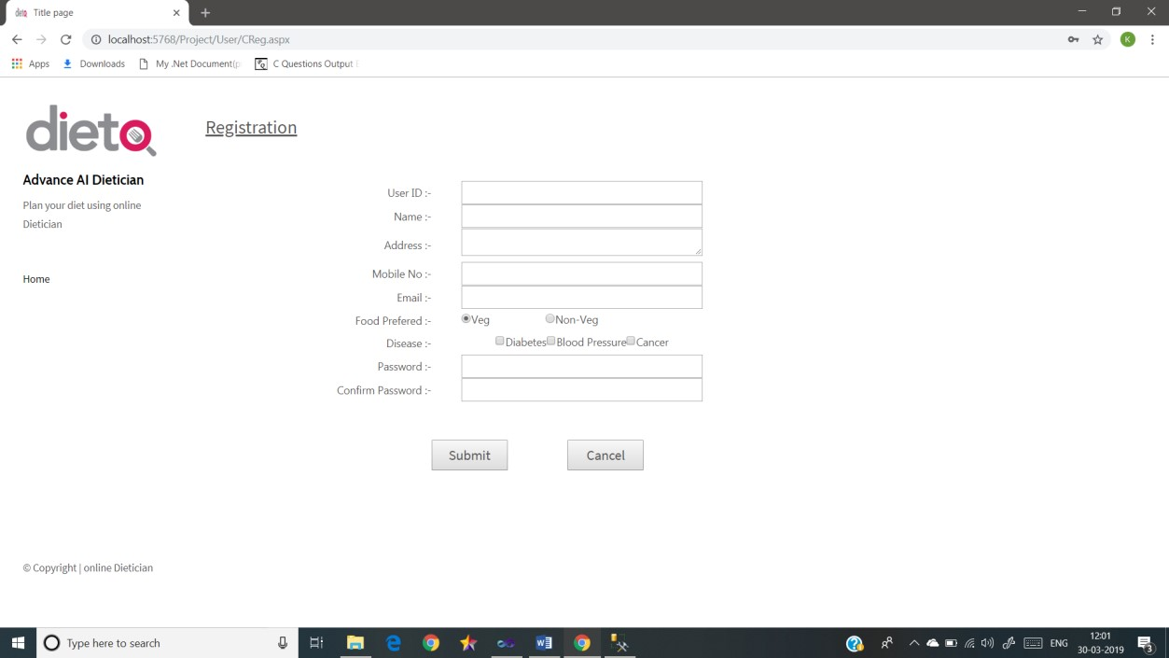

Slide 37
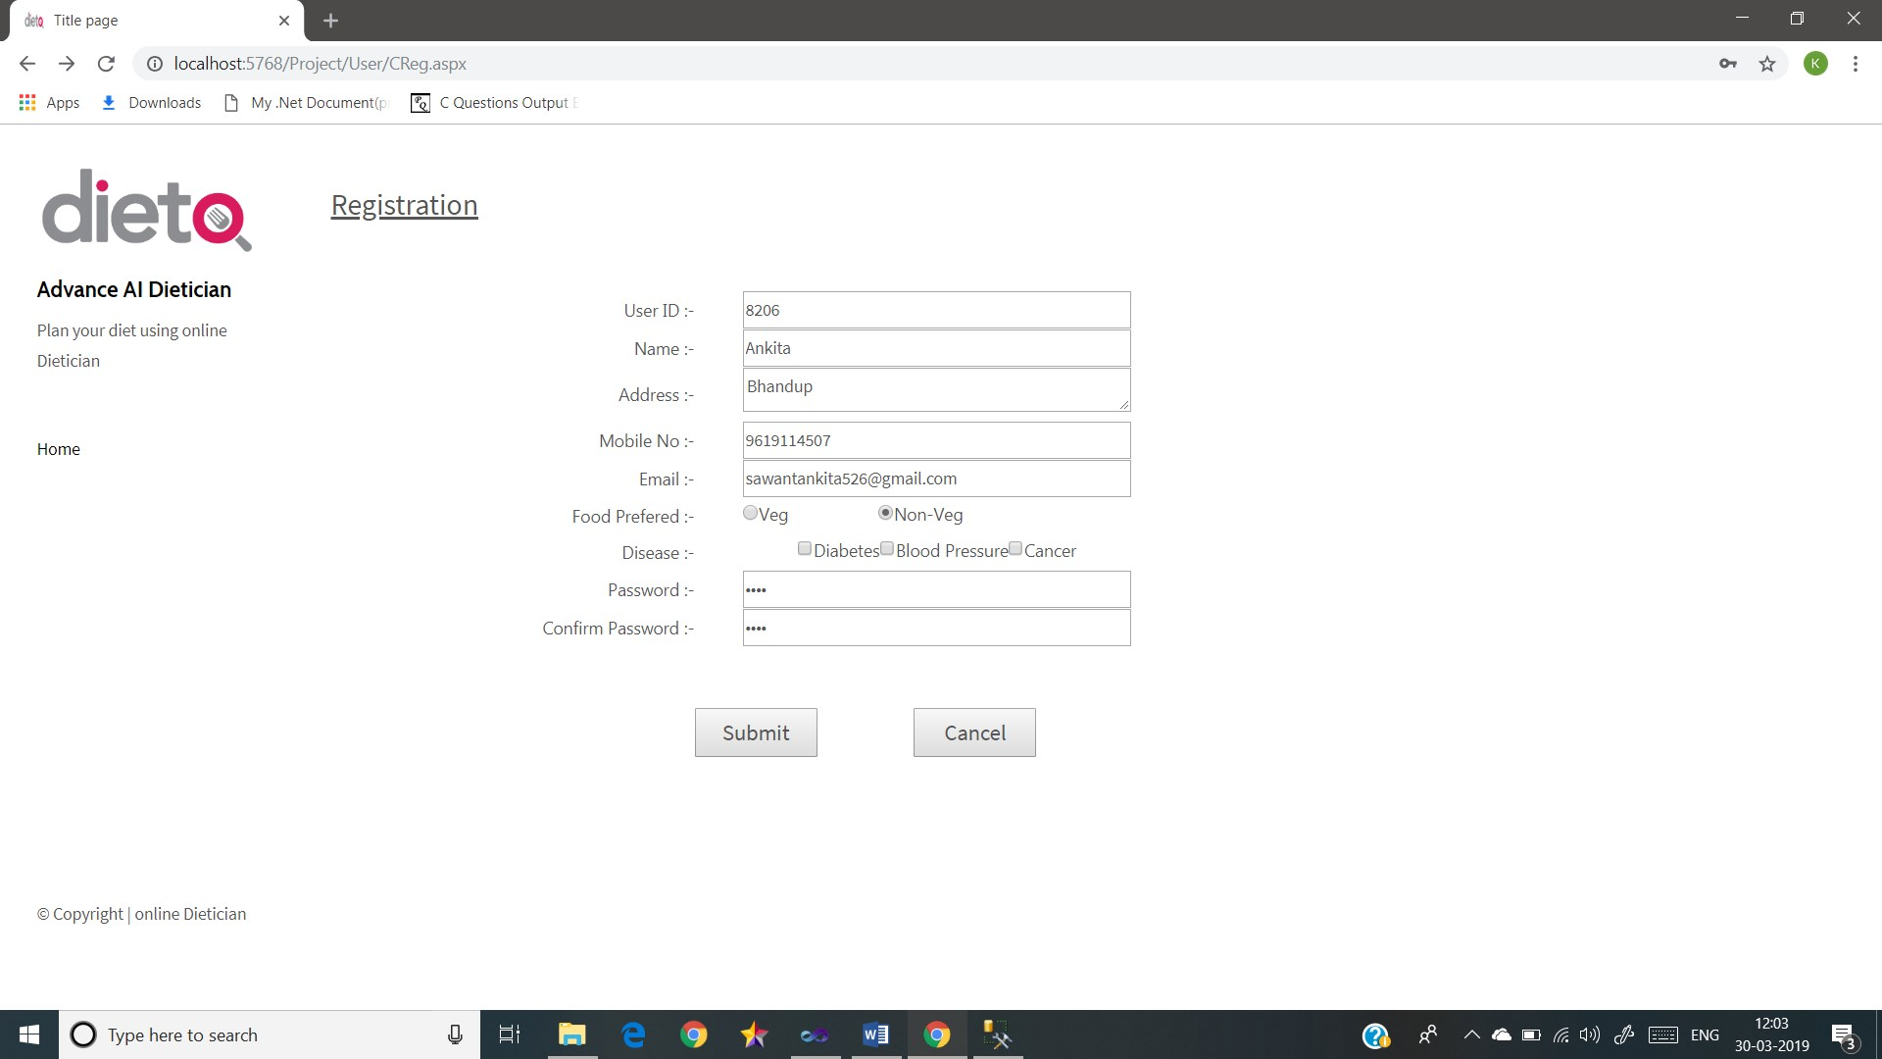

Slide 38
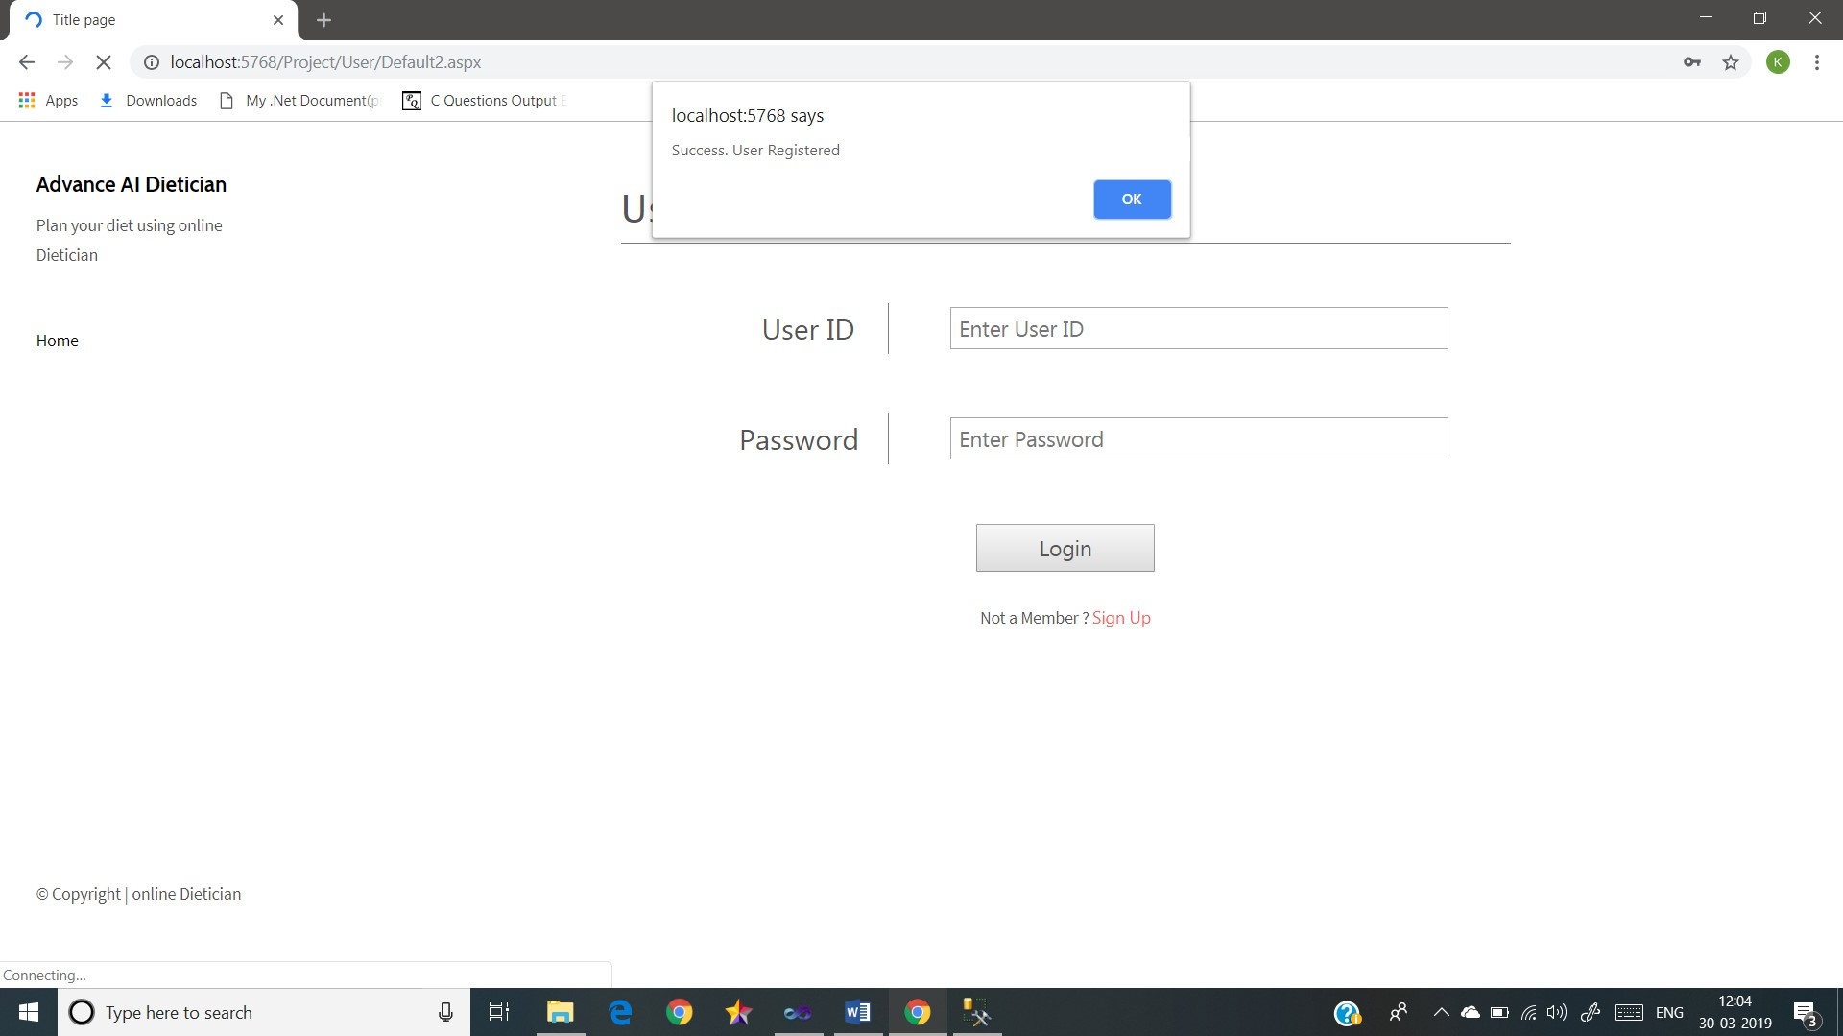

Slide 39
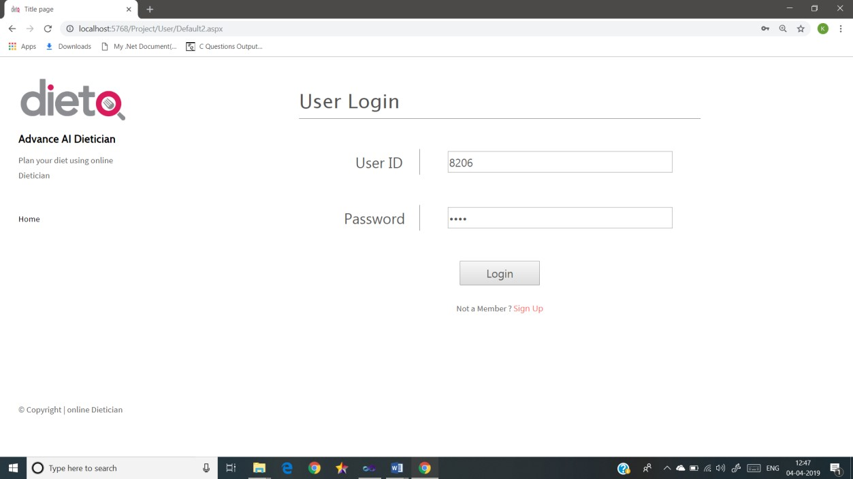

Slide 40
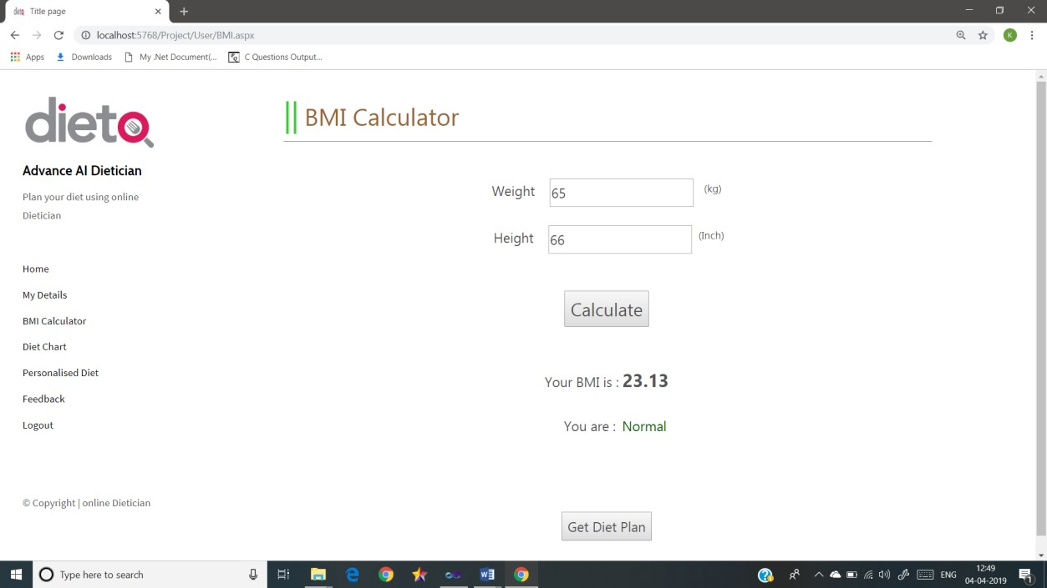

Slide 41
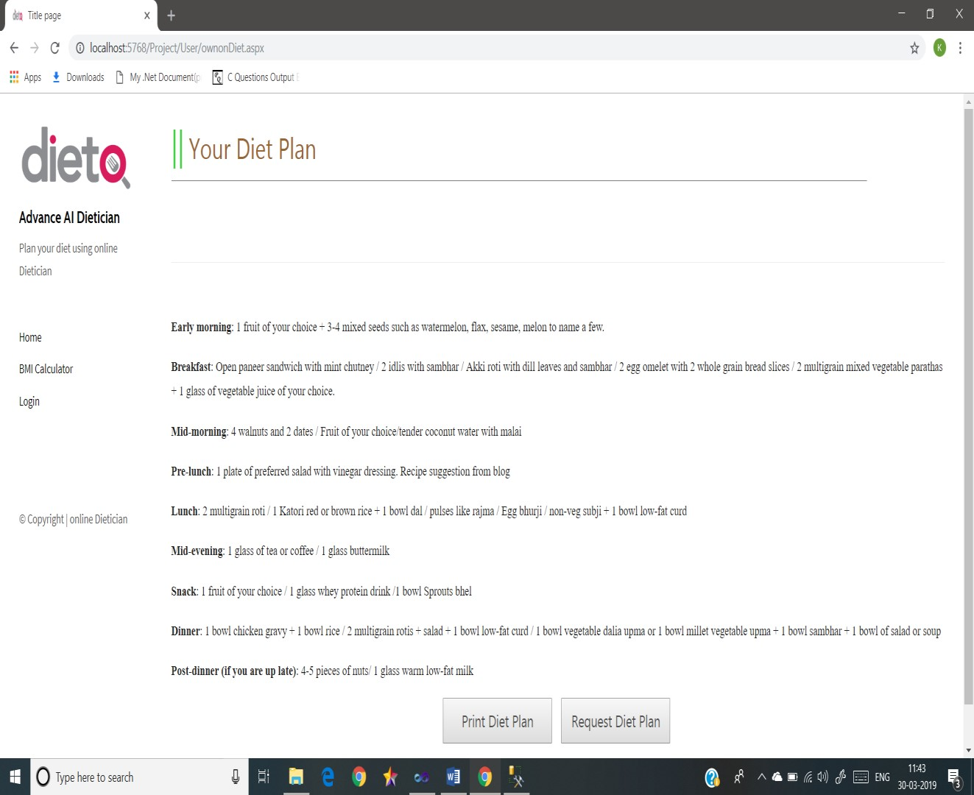

Slide 42
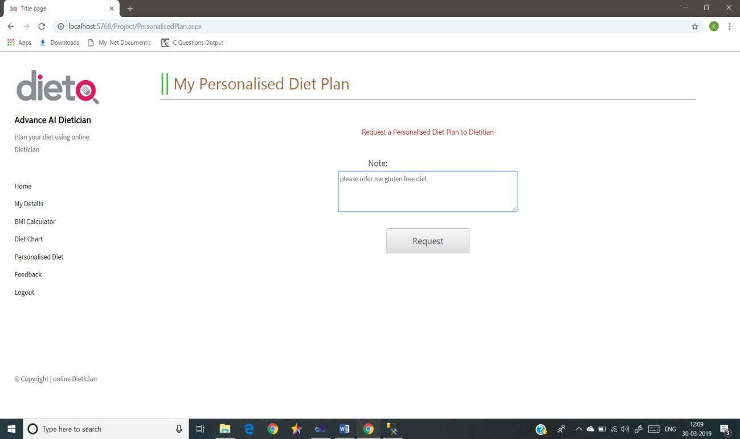

Slide 43
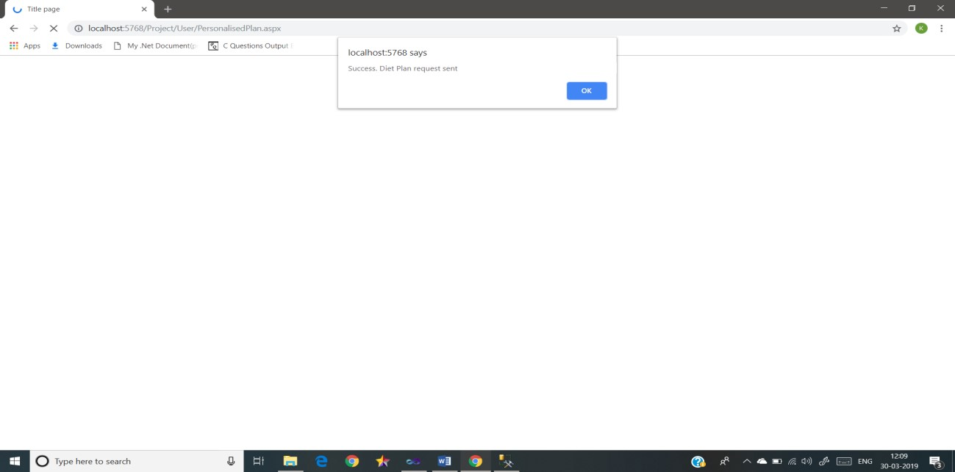

Slide 44
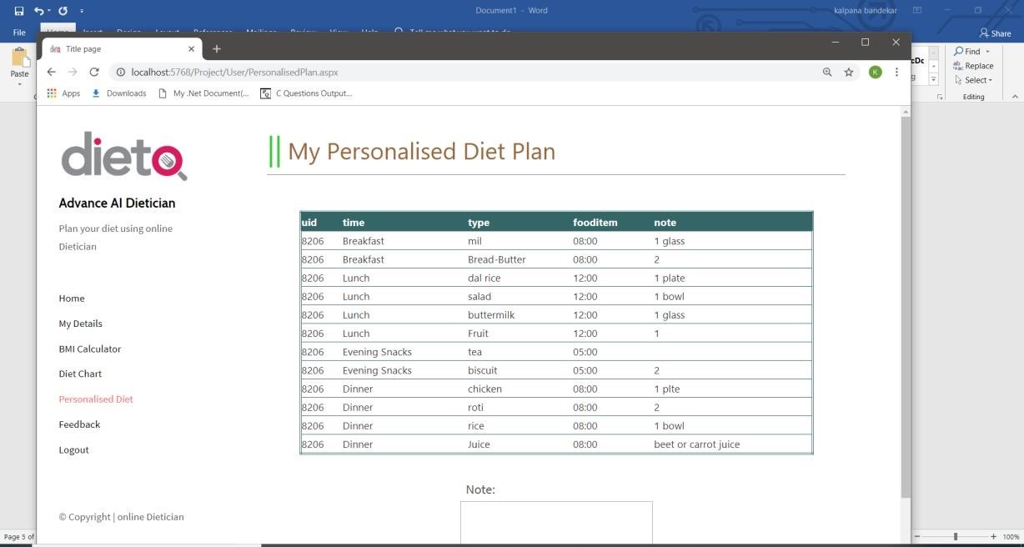
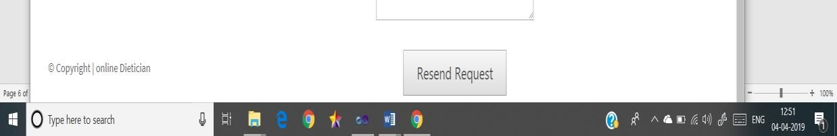

Slide 45
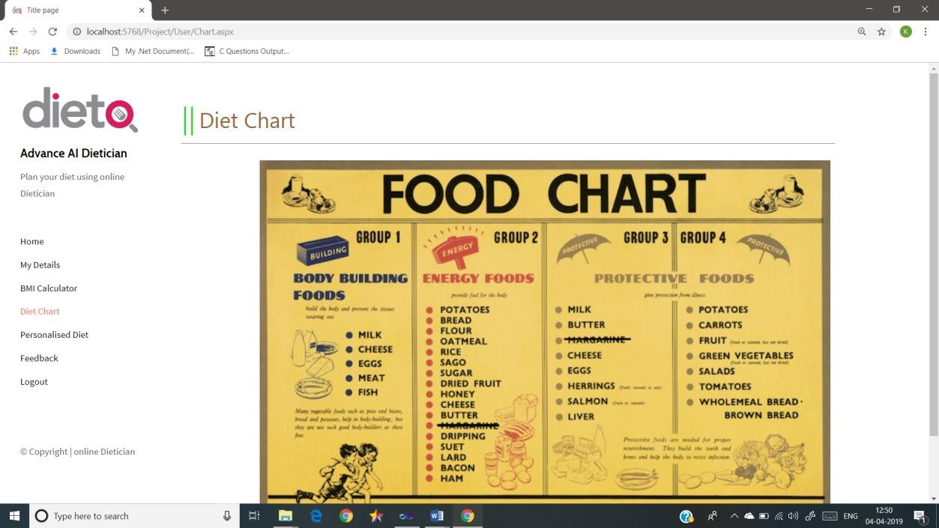

Slide 46
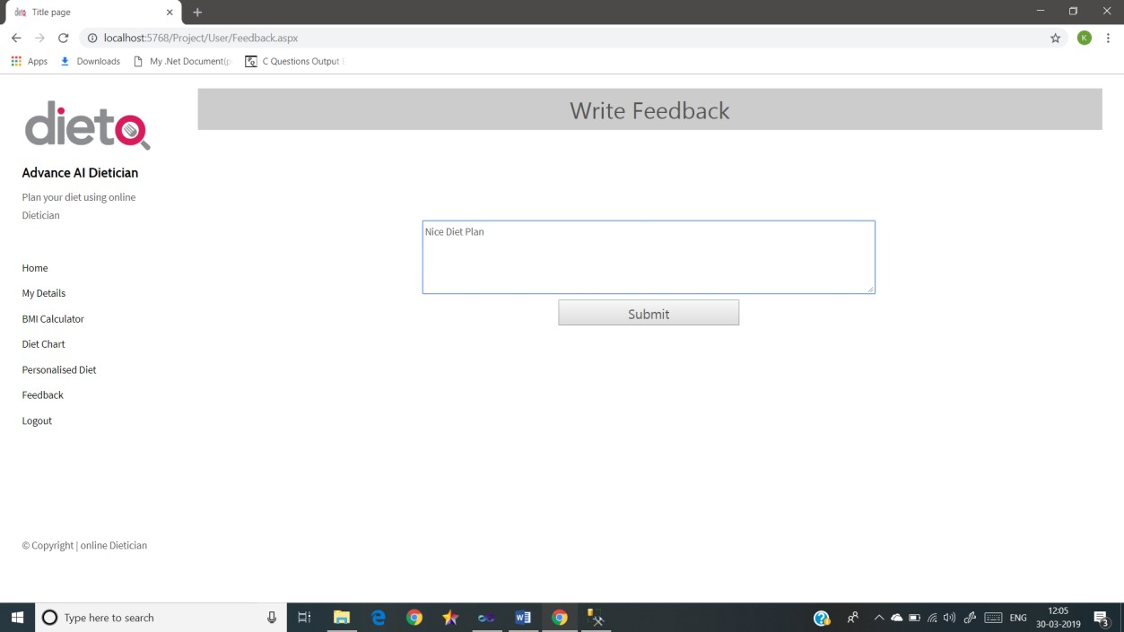

Slide 47
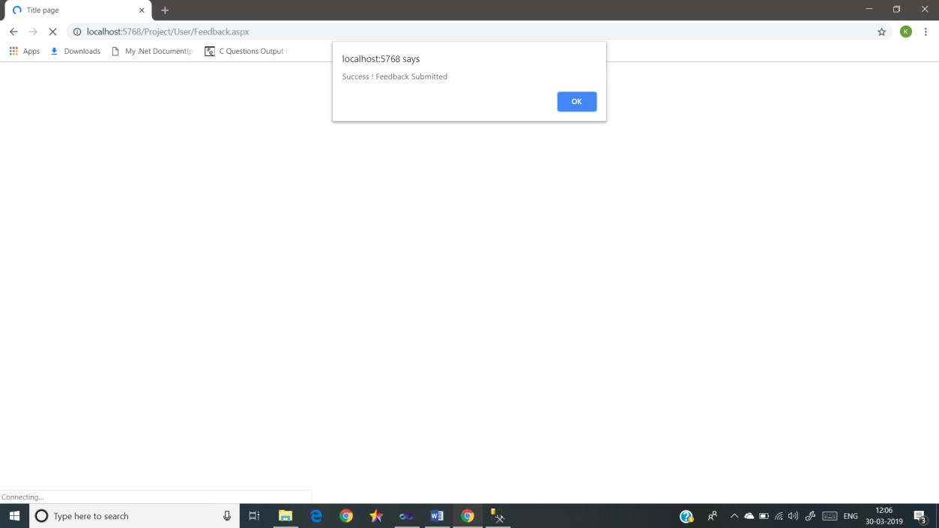

Slide 48
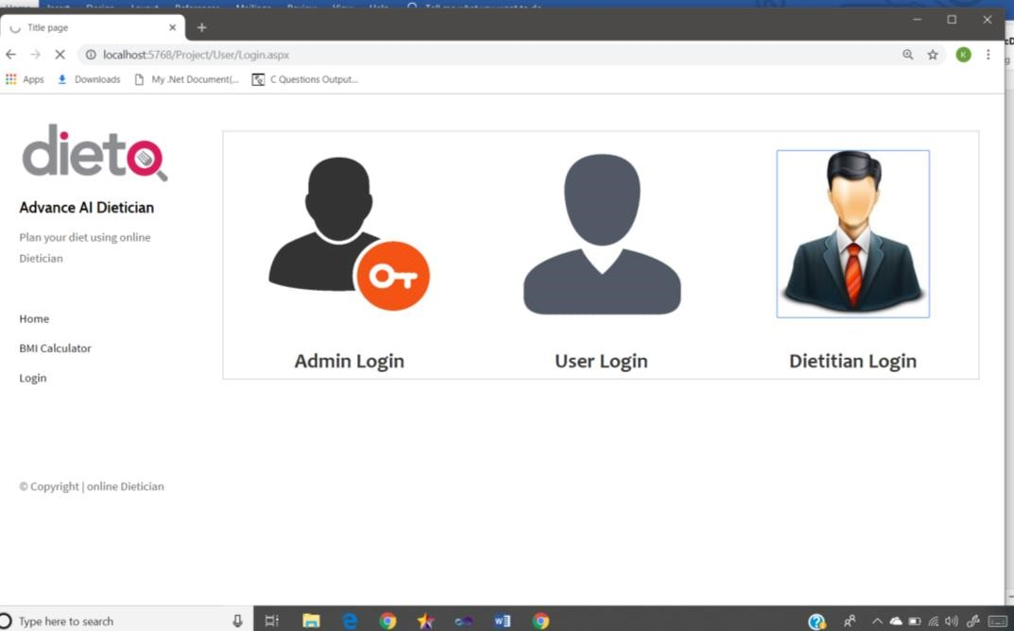
Dietitian Login

Slide 49
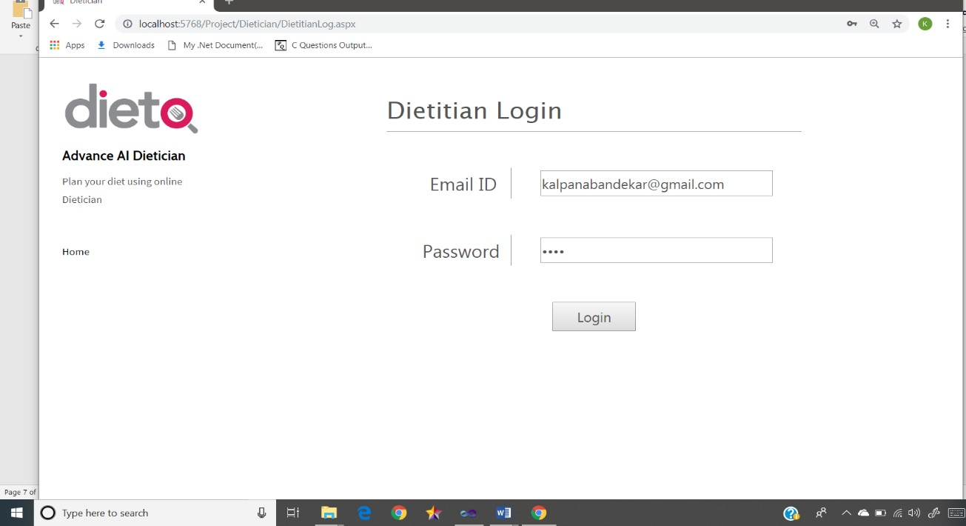

Slide 50
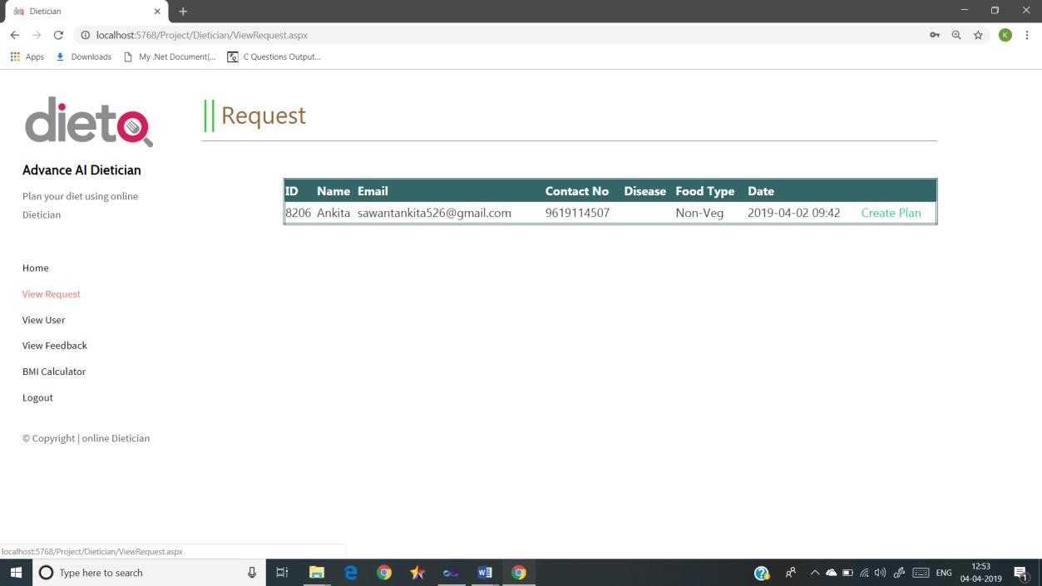

Slide 51
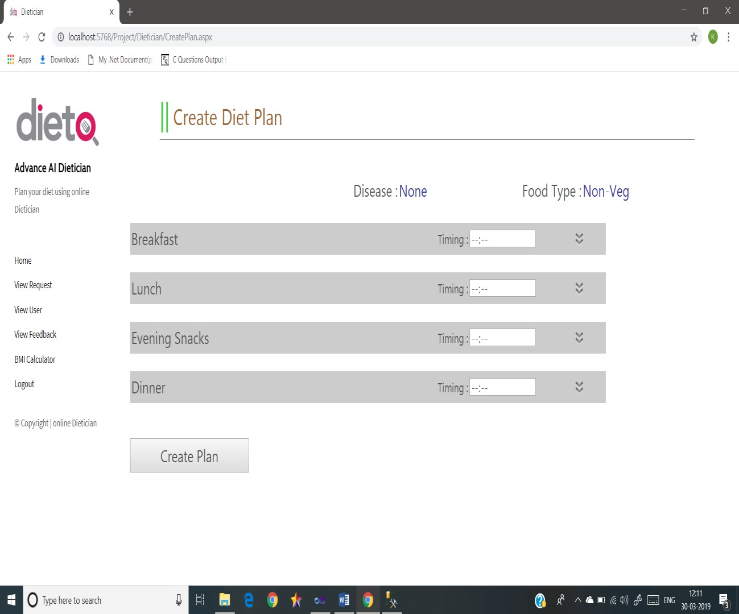

Slide 52
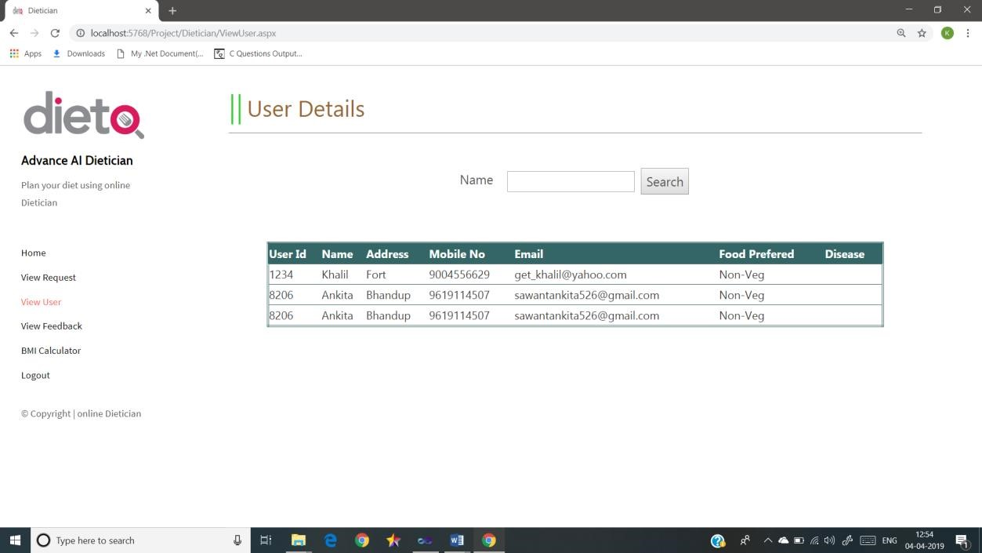

Slide 53
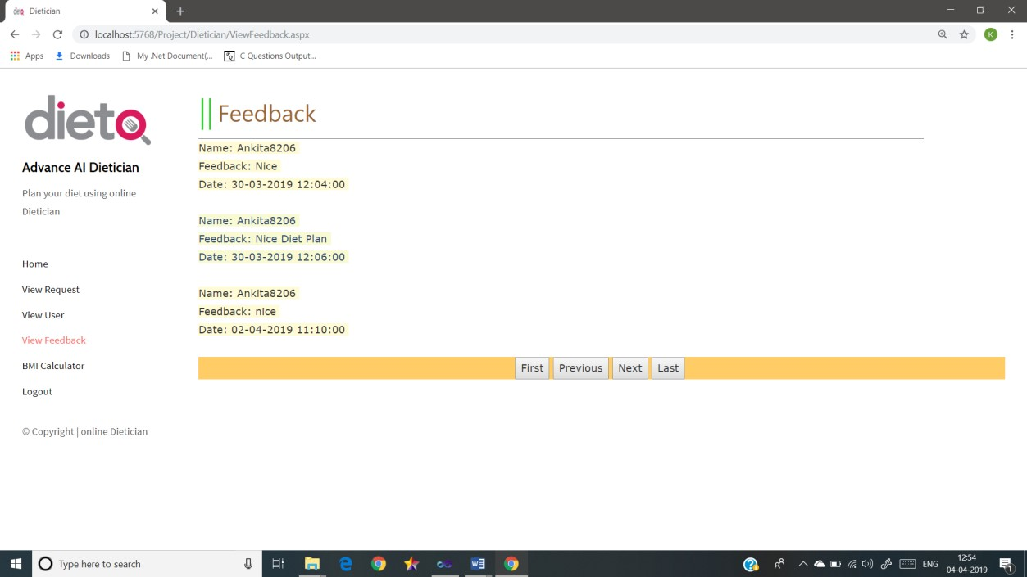

Slide 54
Features
Load Balancing:
Since the system will be available only the admin logs in the amount of load on server will be limited to time period of admin access.
Easy Accessibility:
Records can be easily accessed and store and other information respectively.
User Friendly:
The Website will be giving a very user friendly approach for all user
Efficient and reliable:
Maintaining the all secured and database on the server which will be accessible according the user requirement without any maintenance cost will be a very efficient as compared to storing all the customer data on the spreadsheet or in physically in the record books.
Easy maintenance:
Artificial Intelligence Dietitian website is design as easy way. So maintenance is also easy.

Slide 55
Conclusion
“Online Artificial Intelligence Dietitian” was made such that the problems faced by the health issues nowadays. Our food choices each day affect your health — how we feel today, tomorrow, and in the future.
Good nutrition is an important part of leading a healthy lifestyle. Combined with physical activity, our diet can help us to reach and maintain a healthy weight, reduce our risk of chronic diseases (like heart disease and cancer), and promote our overall health.
These include heart disease, hypertension (high blood pressure), type 2 diabetes, osteoporosis, and certain types of cancer. By making smart food choices, you can help protect yourself from these health problems.
The link between good nutrition and healthy weight, reduced chronic disease risk, and overall health is too important to ignore. By taking steps to eat healthy, you'll be on your way to getting the nutrients your body needs to stay healthy, active, and strong. As with physical activity, making small changes in your diet can go a long way, and it's easier than you think.

Slide 56
This developed System:
1.User can Get Diet Plan according to their weight and height and according to his/her diseases.
2.User can send for the New Diet Plan request if he/she unhappy with the diet plan.
Thus the “Online Artificial Intelligence Dietitian” is effective and efficient site fulfilling the needs required by organization.

Slide 57
ADvantages
No need of consulting doctor for diet plans.
Saves money and very effective and give accurate results as it is coded with keeping diet chart in mind. This system provides full details of the nutrient constitution in body and if required more or not along with the plan by just answering to some queries and user can request for alternate diet plan.

Slide 58
Disadvantages
One has to be sure about their details while entering fields like height weight and many more otherwise this system would give results that is not suitable for user if not sure about what they entered.

Slide 59
Future Scope Of The Project
Being a computer system, the system has lots of scope. It not only efficient but effective also.
As this is computerized system the owner/Admin is completely depend on computer for accessing details about Customers.
Also the software needs to be maintained properly time to time, i.e. if it requires be updating or modifying etc.
Mobile application should be made also for user convenience.
Interface will be made more user friendly and attractive GUI.

Slide 60
Thank You

